Slide 1
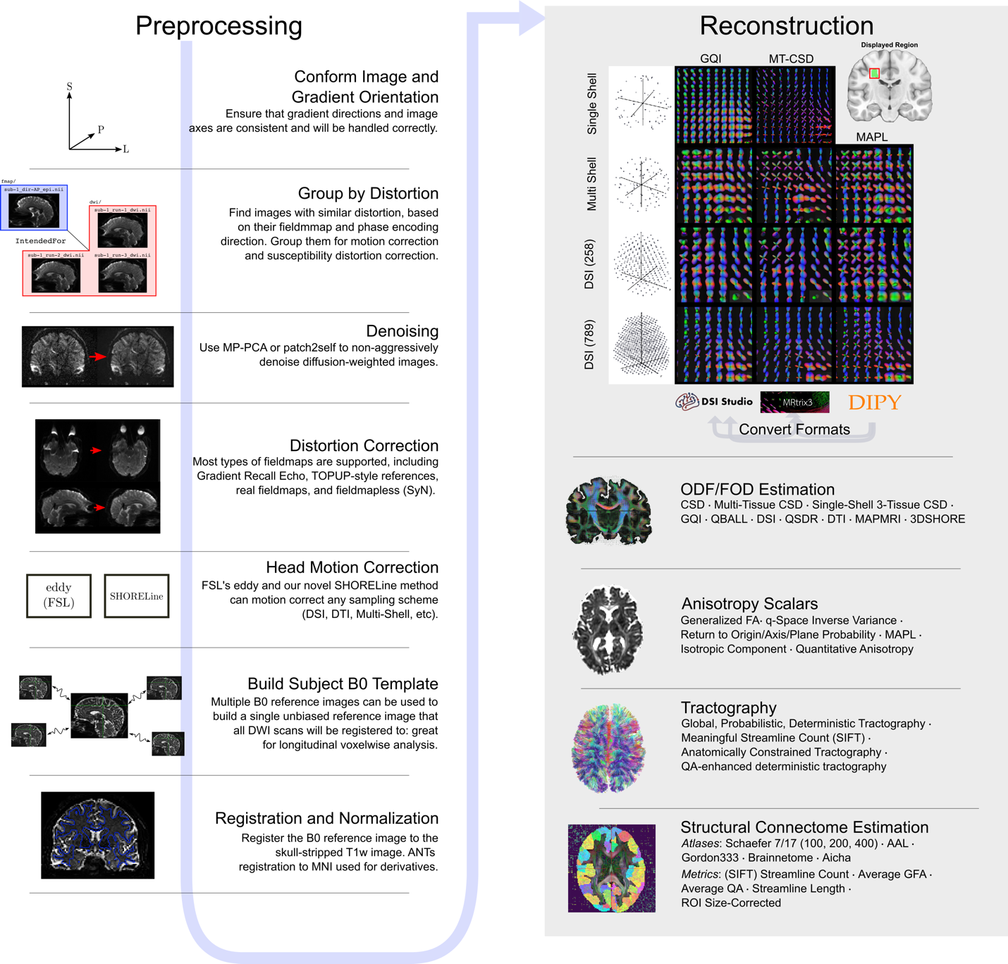
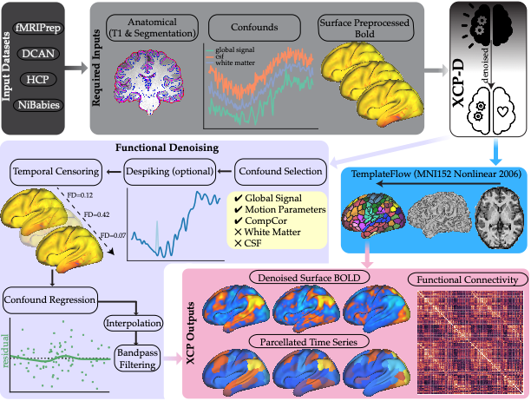
dMRI and fMRI Processing in NiCharts
QSIPrep
XCP-D
>10,000 downloads
>10,000 downloads
Ciric et al., Nature Protocols 2018
Cieslak et al., Nature Methods 2021

Slide 2
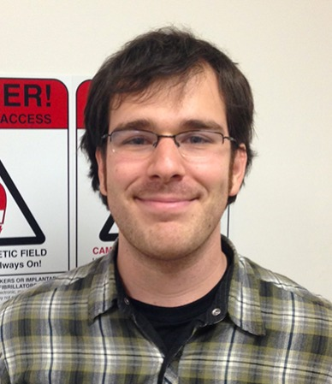
Diffusion Processing with QSIPrep
Matt Cieslak, Ph.D
Senior Scientist
Cieslak et al., Nature Methods 2021
Notes:
Not content to just have these kinds of pipelins for fMRI, Matt Cieslak, a senior scientist in our group, built QSIPrep
QSIPrep is a fully containerized pipeline that can handle nearly any diffusion imaging acquisition.
Because it is a bids app, it reads the imaging paramters from the meta-data encoded in BIDS and automatically configures to build appropriate and reproducible pipleines for the data.
Furthermore, in includes modular reconstruction workfows that are interoperable, allowing users to leverage tools from different software packages that often don’t play well together.
The paper describing it should be out shortly in Nature methods, but QSIPrep has already been downloaded around 6,000 times from dockerhub.

Slide 3
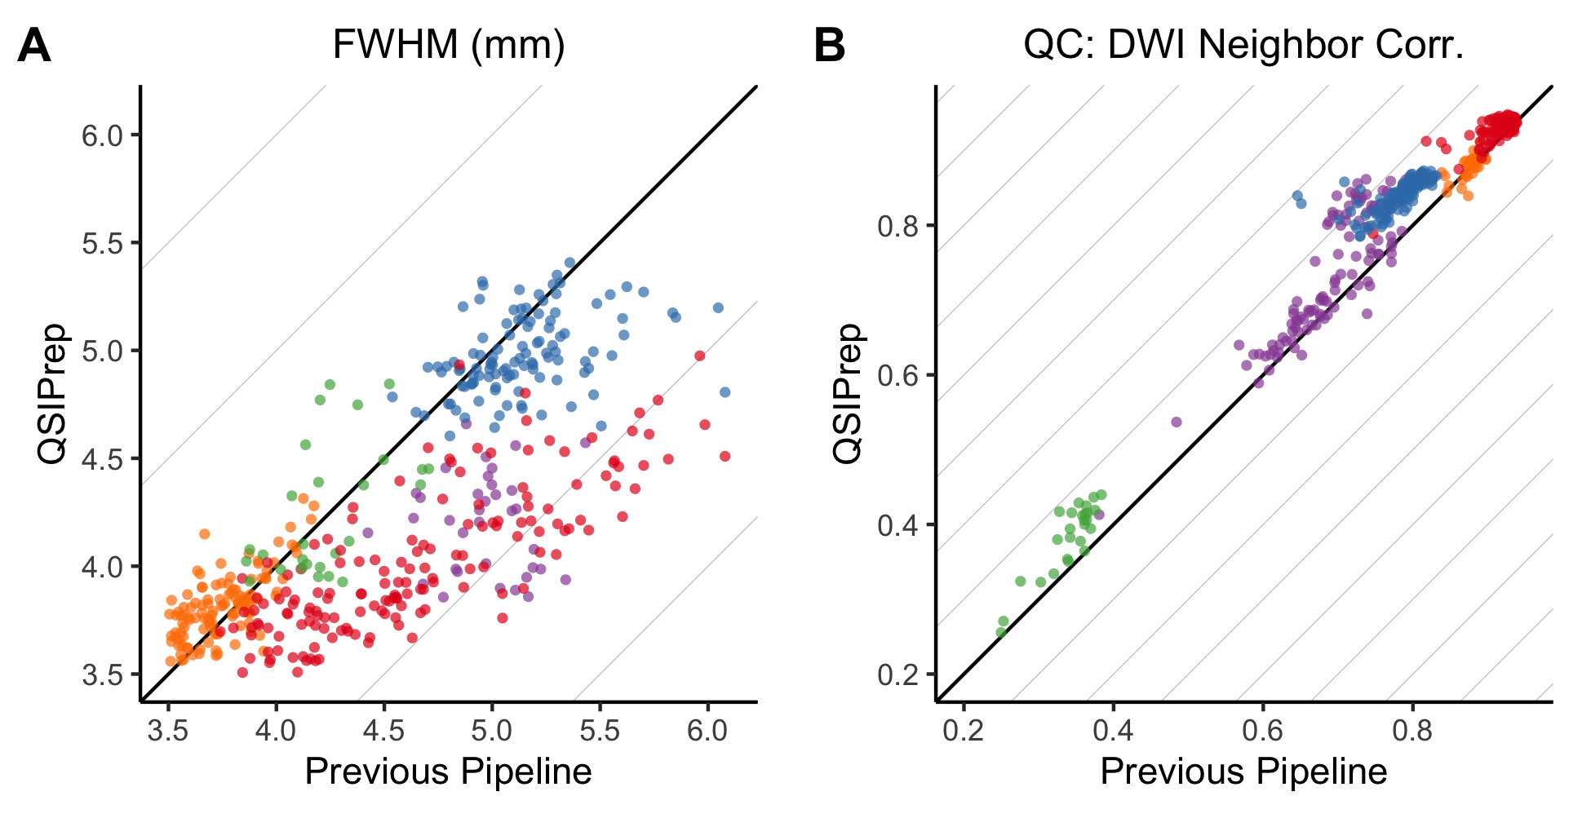
Automatically-Configured Pipelines in QSIPrep Reduce Blurring and Increase Quality
Cieslak et al., Nature Methods 2021
Notes:
As part of the evaluation and testing of QSIPrep, matt looked at many different studies, and compared QsiPrep to custom pipeliens that were used to process the data from those studies.
What he found was that automatically configured pipelines built by QSIPrep performed as well or better than custom pipeleins built for each study.
Specifically, he found that QSIPrep introduced less blurring into the data which allows greater detail to be prserved , but also resulted in higher data quality.

Slide 4
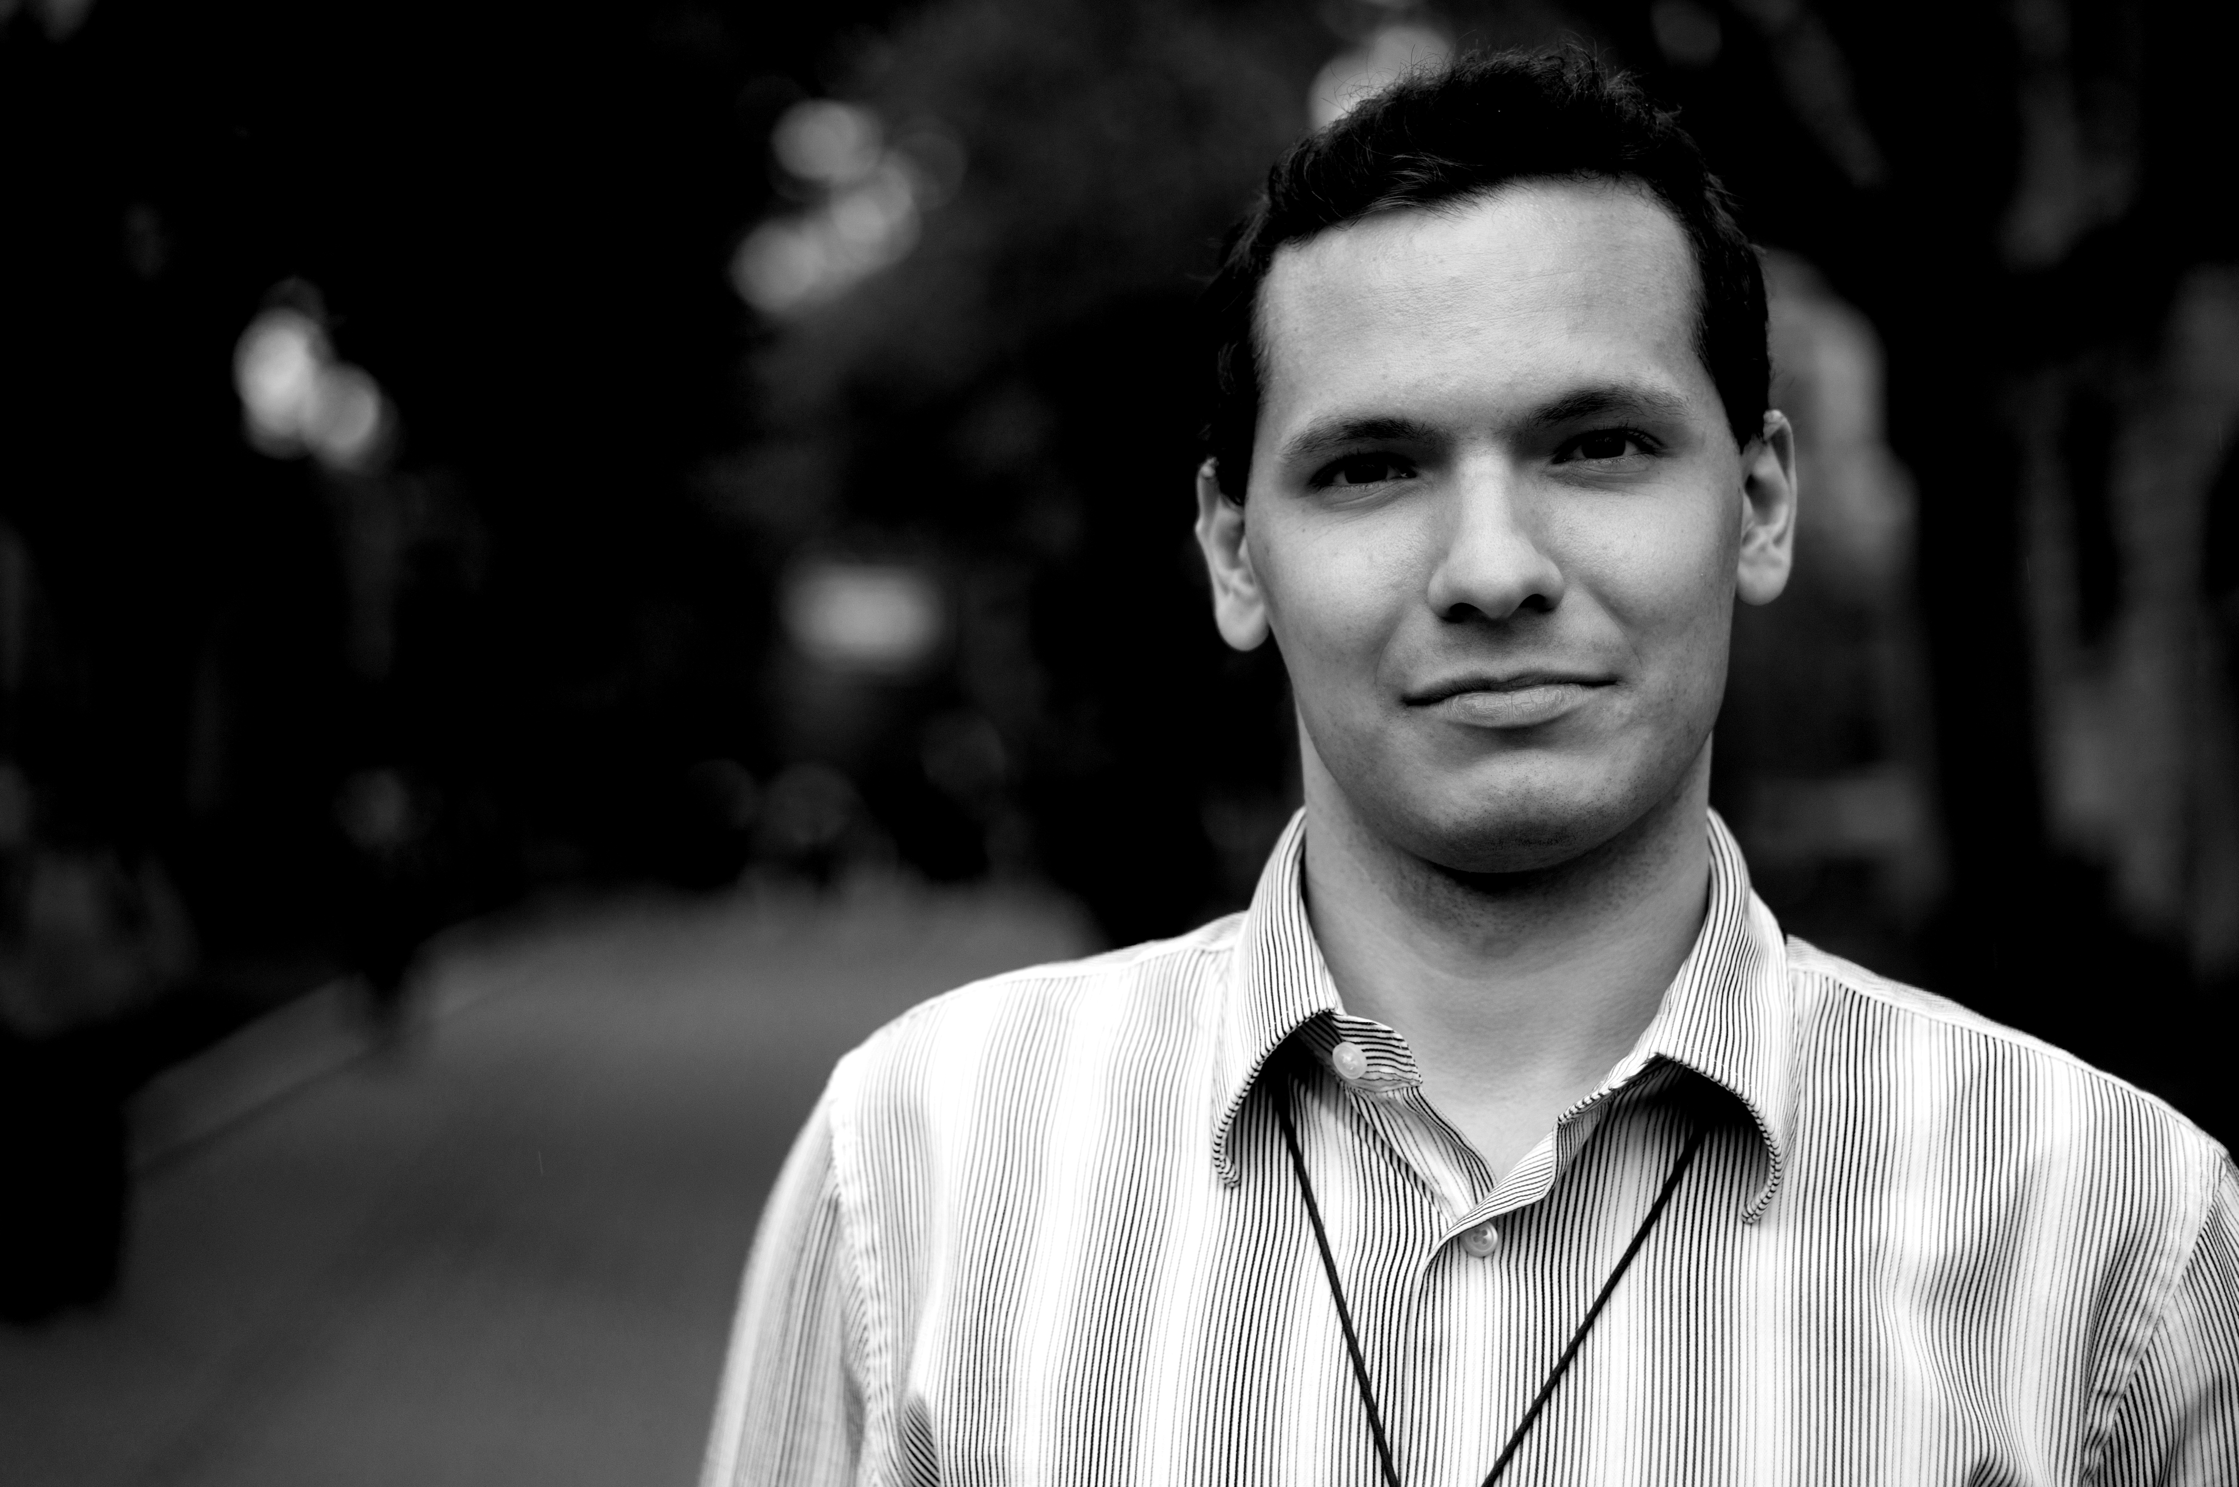
Benchmarking De-Noising Pipelines
Rastko Ciric
Former Data Analyst Stanford Bioengineering
Doctoral Candidate
Ciric et al., Neuroimage 2017

Slide 5
De-Noising Procedures Vary Widely in Performance
Association Between Motion and Functional Connectivity
Ciric et al., Neuroimage 2017

Slide 6
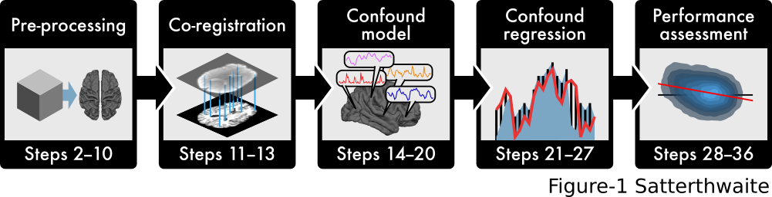
XCP: the eXtensible Connectivity Pipelines
Ciric et al., Nature Protocols 2018

Slide 7
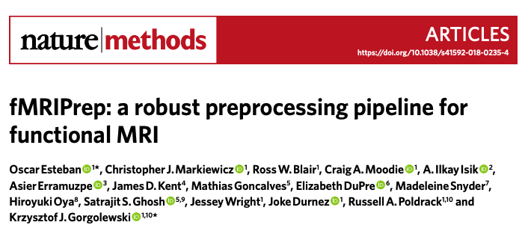
fMRIPrep + XCP-D
Esteban et al., Nature Methods 2019
Ciric et al., Nature Protocols 2018

Slide 8

XCP-D for NiCharts
Fully-refactored in Nipype
Workflow to ingress minimally preprocessed data from UK Biobank / HCP
Extensive new continuous integration testing on CircleCI
Custom workflows to integrate with personalized networks & NiChart atlases
Taylor Salo, PhD
Post-doctoral Software Engineer
Mehta & Salo et al., In Preparation

Slide 9



Open, Test-Driven Development
Open development on Github
Ongoing continuous integration (CI) testing via CircleCI
If CI tests passed, automatically updates container

Slide 10
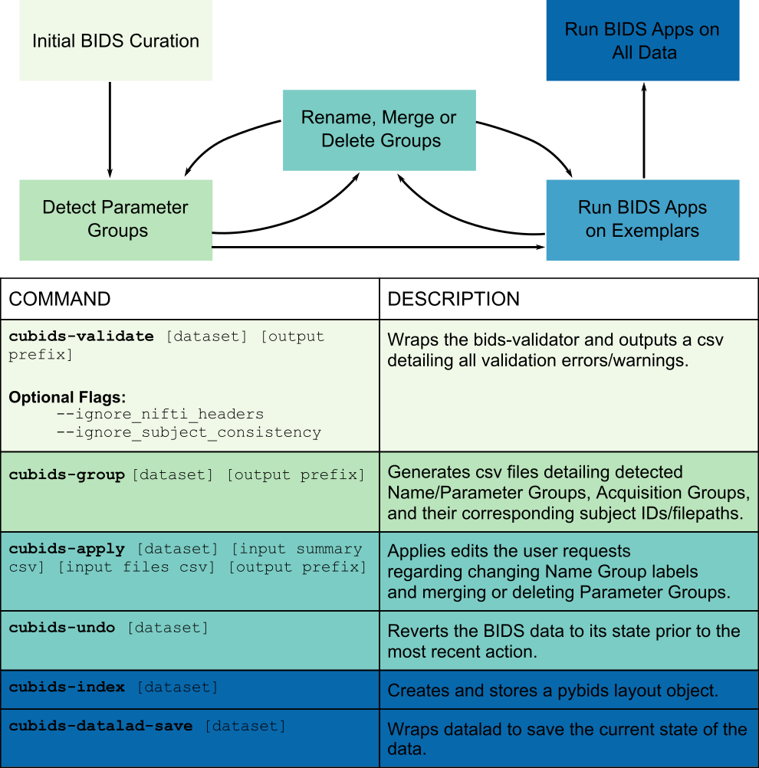
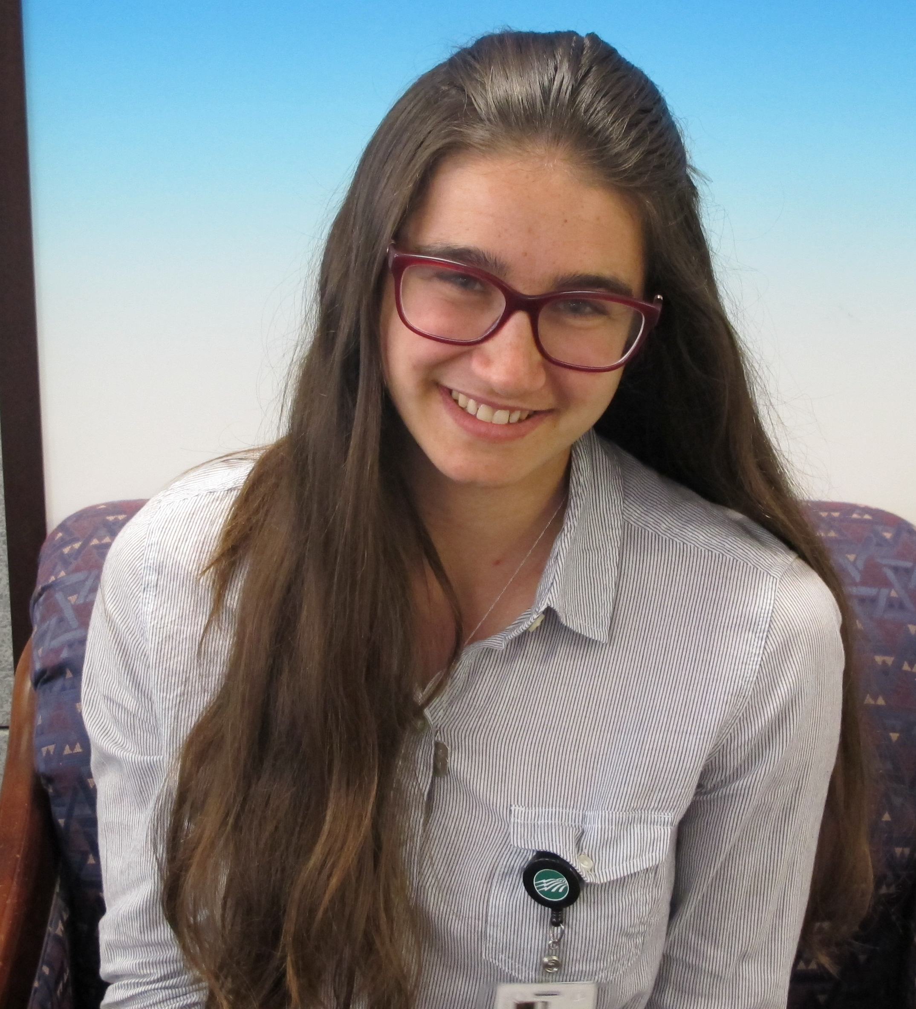
Reproducible Curation of BIDS at Scale: CuBIDS
Sydney Covitz
Software Engineer
Covitz et al., Neuroimage 2022
Figure 1: CuBIDS workflow.
Notes:
Finally, I want to mention a new tool that is being presented here at OHBM called “CuBIDS, for curation of BIDS”, whose development was led by a truly phenomenal data analyst in the lab, Sydney Covitz, together w/Matt Cieslak.
We developed CuBIDS to help quickly assess the variation of BIDS data in large datasets. THis is super important because while containerized BIDS apps are great, because they auto-configure to the data they can produce “correct” but unexpected output based on parameters specified in the input data. This means you really have to know what those parameters specified in BIDS are!
CuBIDS streamlines the workflow of handling heterogenous datasets by detecting all the unique combination of parameter groups in the data.
This allows one to test one’s pipelines a small subset of exemplars in the data that cover the full amount of variation present in a dataset.
Then, once you’ve tested all your exemplars, you can run the the pipeline with confidence on the full dataset and know there are not going to be any surprises.
Importantly, all commands are wrap datalad to ensure a fully reproducible workflow.
To learn more, check out poseter number 1532
CuBIDS is particularly useful for some of the ongoing studies we are doing now

